Slide 1
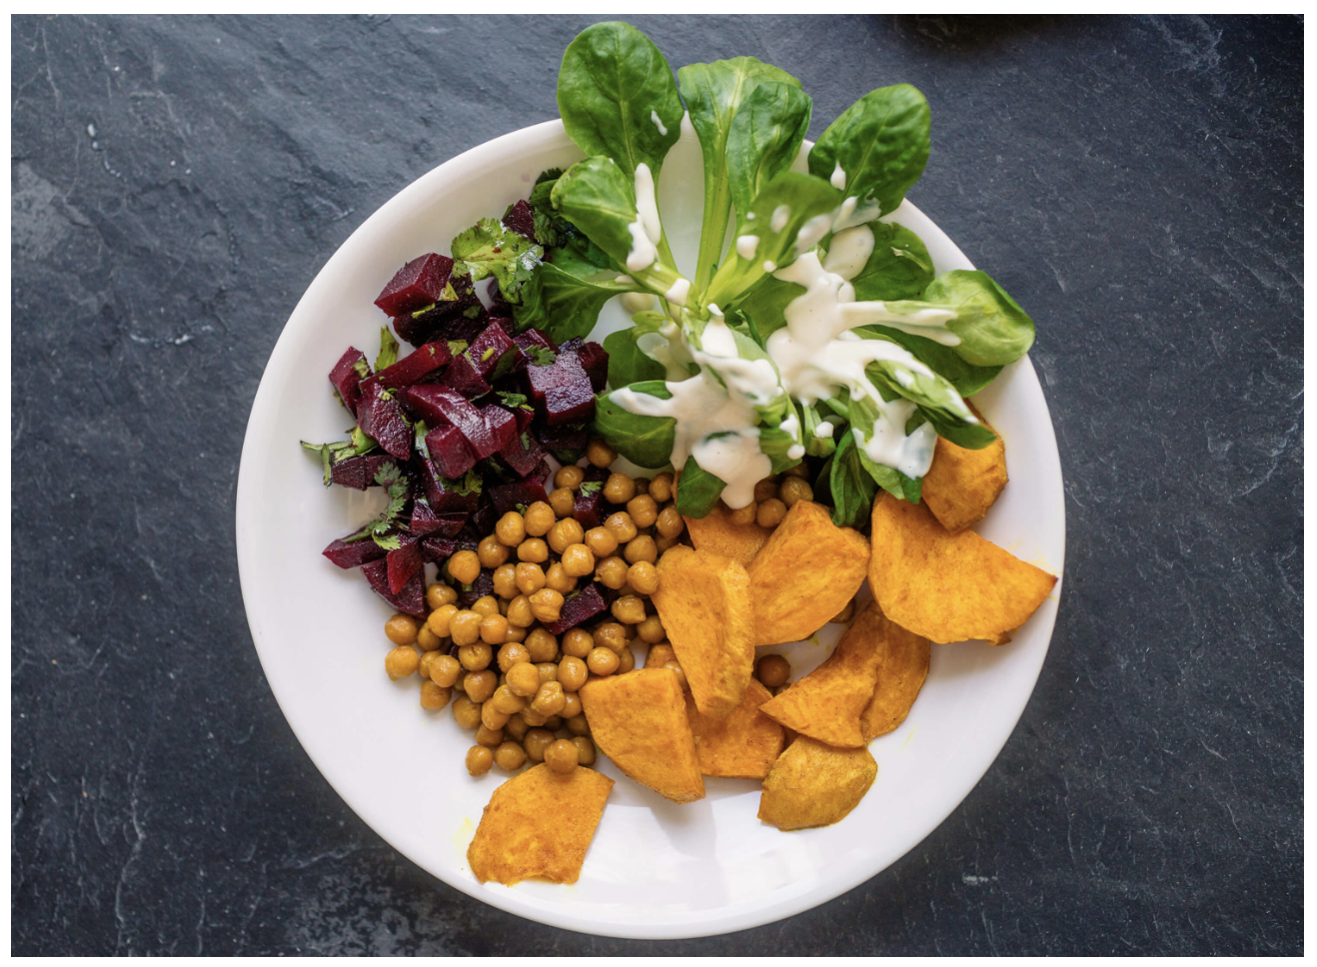
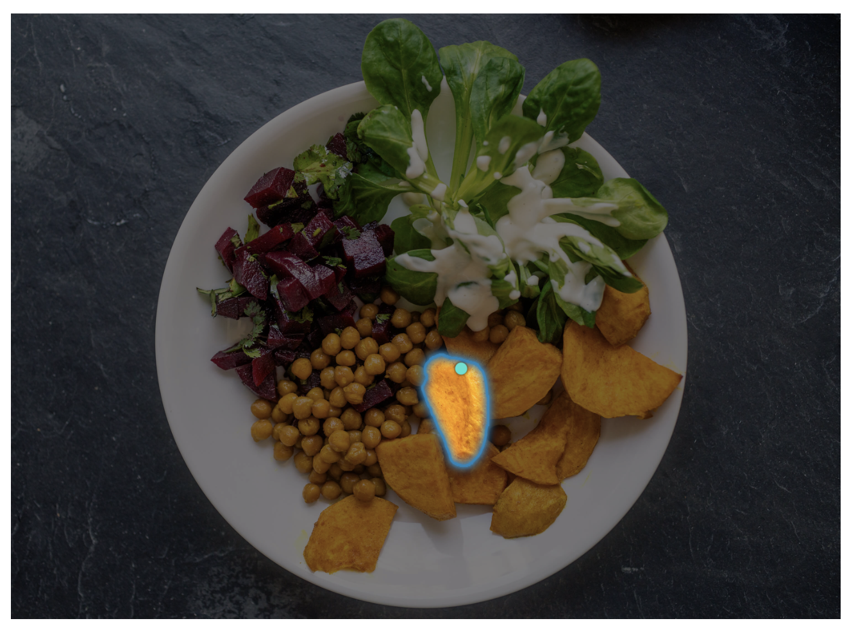
Project 14
Automated Yoga Pose Classification
Good Students
Hesong Zhang(z5532689)
Renfei Yu (z5546743)
Wenxuan Wang (z5464319)
Renhua Luo (z5408176)
Yi Zhao (z5530832)
Notes:
Hello everyone, we are good students, I’m Willa. Our project is automated yoga pose classification.

Slide 2
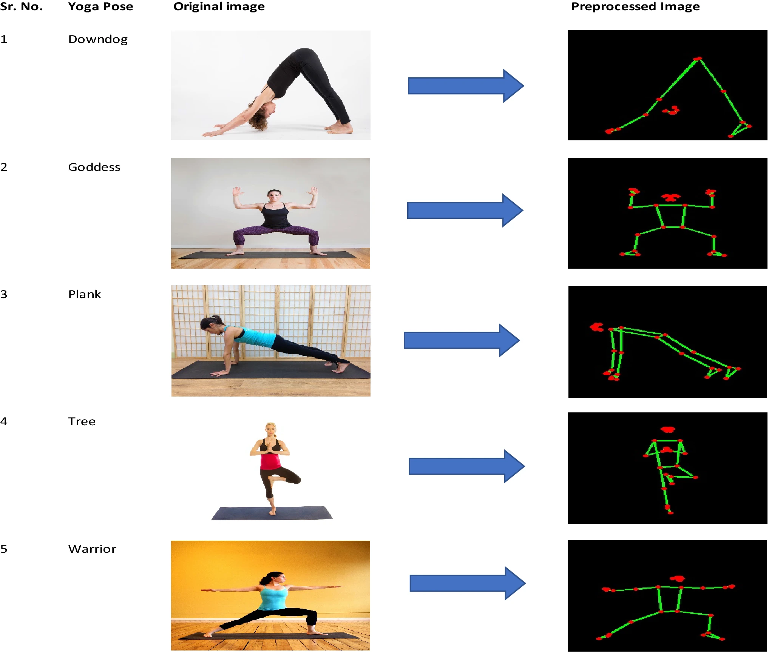
Motivation
Yoga pose classification is important in various domains, including fitness, physical therapy, and sports training.
Accurate identification of yoga poses enhances posture monitoring, correction, and personalized training programs.
Manual classification is time-consuming, prone to errors, and challenging due to the complexity and subtle differences among poses.
Automating this process with deep learning provides a more efficient, accurate, and real-time solution.
One of the core tasks in computer vision
Presenter: Willa(z5464319)
Notes:
Yoga is an ancient fitness activity that enhances both the body and mind through various poses. However, identify each yoga pose accurately is important to ensure right practice, effective monitoring, and timely correction. Unfortunately, manual classification of these poses is not only time-consuming but also cause errors due to the complexity between the poses.

Slide 3
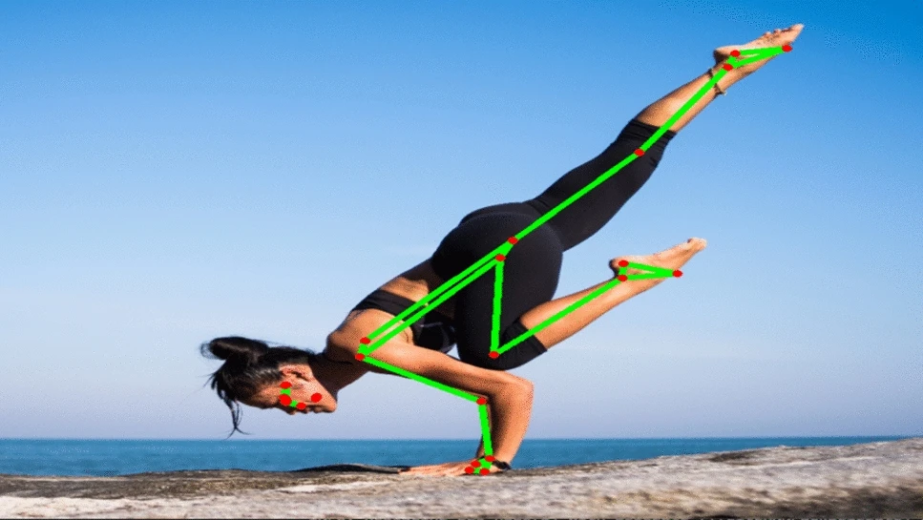
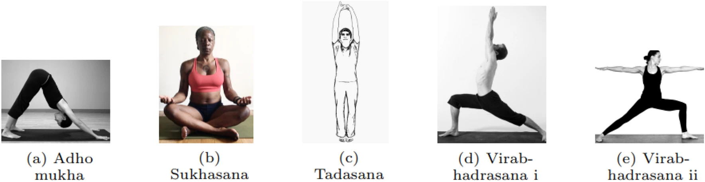
Problem Statement
The wide variety of yoga poses and subtle differences between them make manual visual inspection difficult and error-prone.
An automated system for pose recognition is needed to ensure high accuracy and robustness in varying appearances and angles.
The project aims to develop a neural network-based solution capable of real-time classification for practical deployment.
Using the Yoga-82 dataset, the model will focus on handling complex poses with speed and precision for real-world applications.
Presenter: Willa(z5464319)
Notes:
Here, we propose a solution: use deep learning technology to automate the yoga poses recognition. This can increase efficiency and ensure accuracy and real-time nature of the classification. This method can be applied in individual yoga practices to help people improve their poses and also help teachers in managing large classes.
Our project use a dataset called Yoga-82, which contains a large collection of image covering 82 different yoga poses. Our goal is to develop a neural network model that can identify complex yoga poses in real-time, even when poses are observed from different angles.
In summary, through this project, We aim to promote the technical advancement of yoga practice, so that people who love yoga can practice yoga more safely and scientifically, and also increase the application of computer vision in the health and fitness field.
Ok, Let’s move on to the next part.

Slide 4
Literature Review
Yoga pose classification: a CNN and MediaPipe inspired deep learning approach for real-world application - Garg, S., Saxena, A., & Gupta, R. (2023).
Methods: The paper presents a CNN-based model, YogaConvo2d, for classifying yoga poses. The dataset of 1551 images representing five yoga poses is preprocessed using MediaPipe, which skeletonizes the images by detecting key body points, reducing background interference. YogaConvo2d, a 10-layer CNN, is trained on these skeletonized images, using image augmentation to prevent overfitting. The model is compared against VGG16, InceptionResNetV2, InceptionV3, and NASNetMobile, using both skeletonized and non-skeletonized datasets.
Conclusion: The study shows that using skeletonized images improves model performance. YogaConvo2d achieves the highest accuracy (99.62%) and outperforms other models. Its low latency and high accuracy make it suitable for real-time yoga pose classification. Future work may involve applying the model to video-based pose detection.
Yoga-82: A New Dataset for Fine-grained Classification of Human Poses - Verma, M., Kumawat, S., Nakashima, Y., & Raman, S. (2020)
Methods: Ashraf et al. proposed a novel convolutional neural network (CNN) architecture named YoNet, which draws inspiration from the Xception model. The primary feature of this model is its use of depthwise separable convolutions, which significantly reduce the number of trainable parameters while accelerating the computation process. YoNet's architecture comprises standard convolutional layers alongside depthwise separable convolution layers, batch normalization, and activation functions, all aimed at enhancing the training process and improving the generalization capabilities of the model.
Conclusion: YoNet exhibited superior performance compared to existing state-of-the-art models such as ResNet and InceptionNet. In experimental evaluations, YoNet achieved 94.91% accuracy and 95.61% precision, showcasing its efficiency in both computational cost and classification accuracy. The utilization of depthwise separable convolutions was found to effectively handle complex image features without compromising model performance, offering a robust solution for yoga pose classification.
YogNet: A two-stream network for realtime multiperson yoga action recognition and posture correction- Santosh Kumar Yadav, Aayush Agarwal, Ashish Kumar, Kamlesh Tiwari, Hari Mohan Pandey, Shaik Ali Akbar
Methods: The paper proposes Yoganet, a multi-person yoga expert system designed to recognize 20 yoga positions and provide real-time action recognition and posture correction. The method uses a two-stream deep spatiotemporal neural network architecture, where the first stream captures postural features through CNNs and use LSTM to give temporal predictions. The second stream uses 3D-CNNs for spatiotemporal features extraction from RGB videos. The scores of 2 streams are then combined. The YAR dataset is used and it contains 1206 videos of 20 different yoga positions recorded from 4 view variations (front, back, left and right sides).
Conclusion: The system us able to achieve 77.29%, 89.29%, and 96.31% accuracies for pose stream, RGB stream and the combination of both streams, respectively. The accuracy is measured based on the ratio of correctly classified positions to the total number of positions in the test dataset
Presenter: Renhua Luo (z5408176)

Slide 5
Literature Review
YoNet: A Neural Network for Yoga Pose Classification Ashraf, FB, Islam, MU, Kabir, MR & Uddin, J 2023, ‘YoNet: A Neural Network for Yoga Pose Classification’, SN computer science, vol. 4, no. 2, pp. 198–198.
To develop a deep learning-based model capable of identifying five different yoga poses and to compare its performance with several state-of-the-art image classification models.
Methods:Proposed a novel convolutional neural network (CNN) architecture named YoNet, inspired by the Xception model, particularly utilizing depthwise separable convolutions to reduce the number of model parameters and speed up computations.The architecture includes standard convolution layers, depthwise separable convolution layers, batch normalization, and activation functions to optimize the training process and improve model generalizability.
Conclusion:YoNet demonstrated superior performance in experiments, achieving 94.91% accuracy and 95.61% precision, outperforming other compared models such as ResNet and InceptionNet.The experiments illustrated that depthwise separable convolutions reduce computational costs and effectively handle image features while maintaining high accuracy.
A View Independent Classification Framework for Yoga Postures - Chasmai, M., Das, N., Bhardwaj, A., & Garg, R. (2022).
Methods: The framework proposed in the paper relies on transfer learning techniques from existing human pose estimation models. The authors used models to extract 136 key points of the body and trained a Random Forest classifier to recognize yoga postures based on these key points. The dataset for the study was carefully constructed, including video data from 51 subjects performing 20 yoga poses captured from four different camera angles.
Conclusion:A novel three-step evaluation process was introduced to ensure the classifier's generalizability. This evaluation tests the model's performance on unseen frames, unseen subjects, and unseen camera angles, which ensures the robustness of the model in real-world applications. The paper also highlights that cross-validation techniques must be applied with care to avoid target leakage, which can lead to misleading accuracy results.
Presenter: Renhua Luo (z5408176)

Slide 6
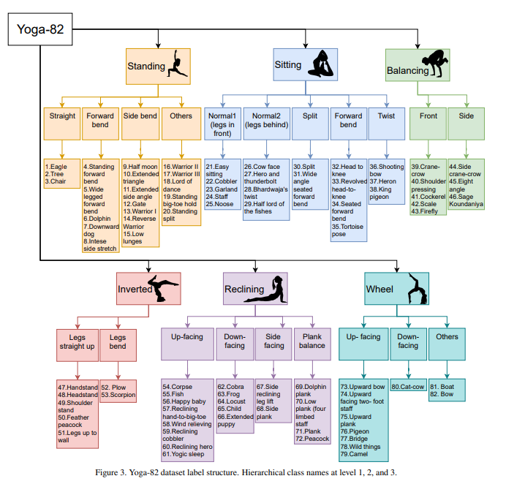
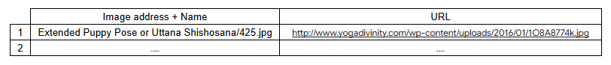
Dataset(s)
The image dataset is obtained from a paper titled “Yoga-82: A New Dataset for Fine-grained Classification of Human Poses”: https://neurohive.io/en/news/yoga-82-new-dataset-with-complex-yoga-poses/
The dataset (Yoga-82) contains over 28,000 images of yoga poses across 82 unique classes, each representing a different yoga pose. The dataset contains includes poses from various camera angle and in different environments, with a mix of clean and complex backgrounds. Image formats include JPG and PNG, and of various resolutions.
Yoga-82 uses a 3-level hierarchical structure where:
Level 1 represents 6 main categories, such as standing, sitting, balancing, inverted etc, and
Level 2 represents 20 subcategories across level 1 main categories, representing variations such as leg position or orientations (e.g. forward bend or side bend etc), and
Level 3 is the specific yoga pose and there are 82 poses in total
Each of the 82 individual poses (also text files) contains image details and URL links to the images hosted on various websites as follows:
The author provided 2 lists of images to be splitted into train set and test set. However, due to invalid images in the dataset (more details next page), we splitted the dataset into 80% train set () and 20% test set () based on the level 3 classes ourselves.
Note that in this project, we focused only on level 3 yoga poses and treat each pose as a separate class. Therefore, we have 82 classes
Presenter: Renhua Luo (z5408176)
Notes:
Row: Each row corresponds to each image detail
Column: The columns are <image_address+name> , <label of class_6> , <label of class_20> , <label of class_82>

Slide 7
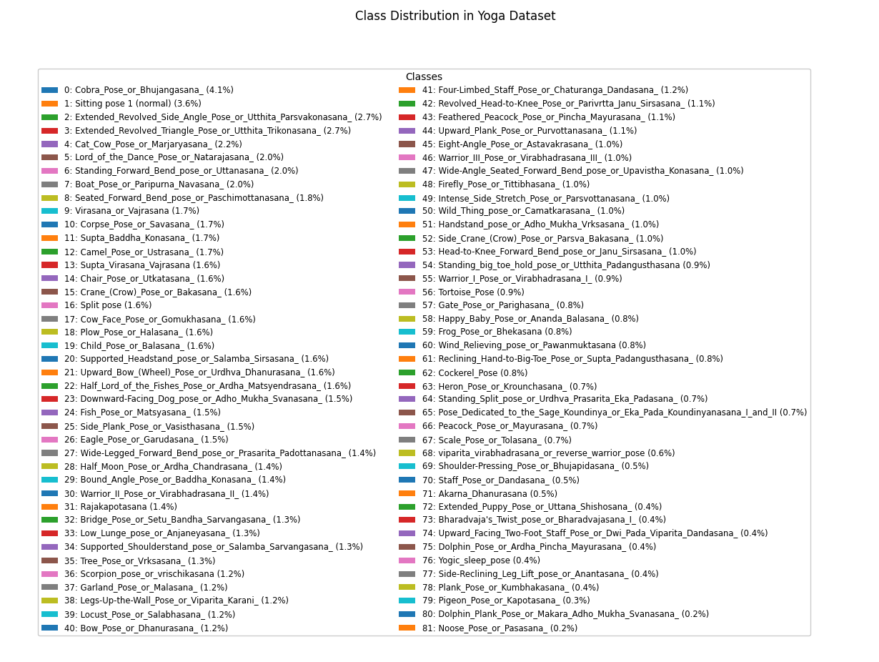
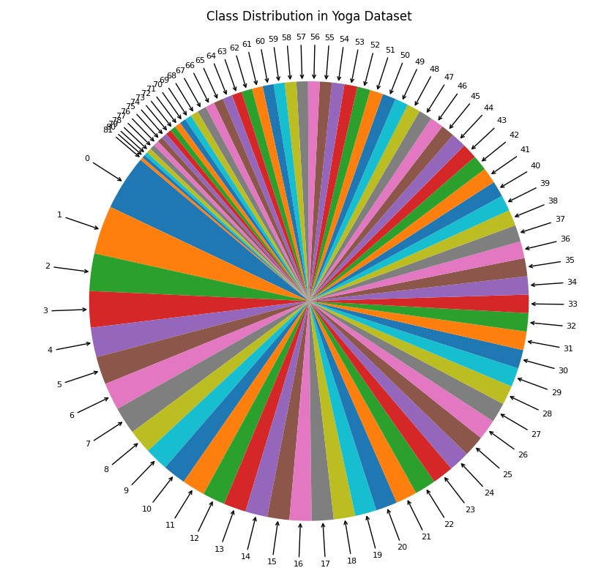
Data Analysis (cont.)
Class distribution of the 82 yoga poses:
Presenter: Renhua Luo (z5408176)

Slide 8
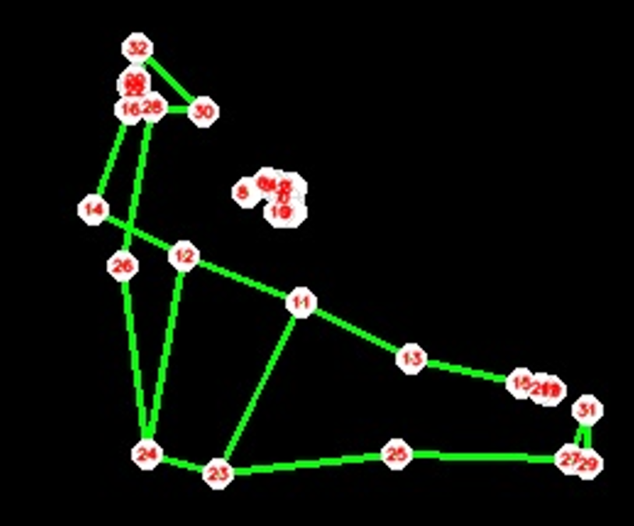
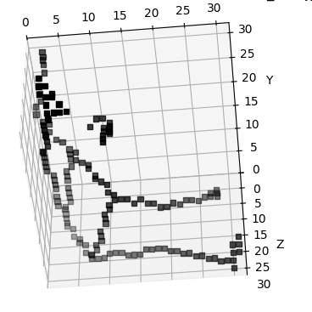
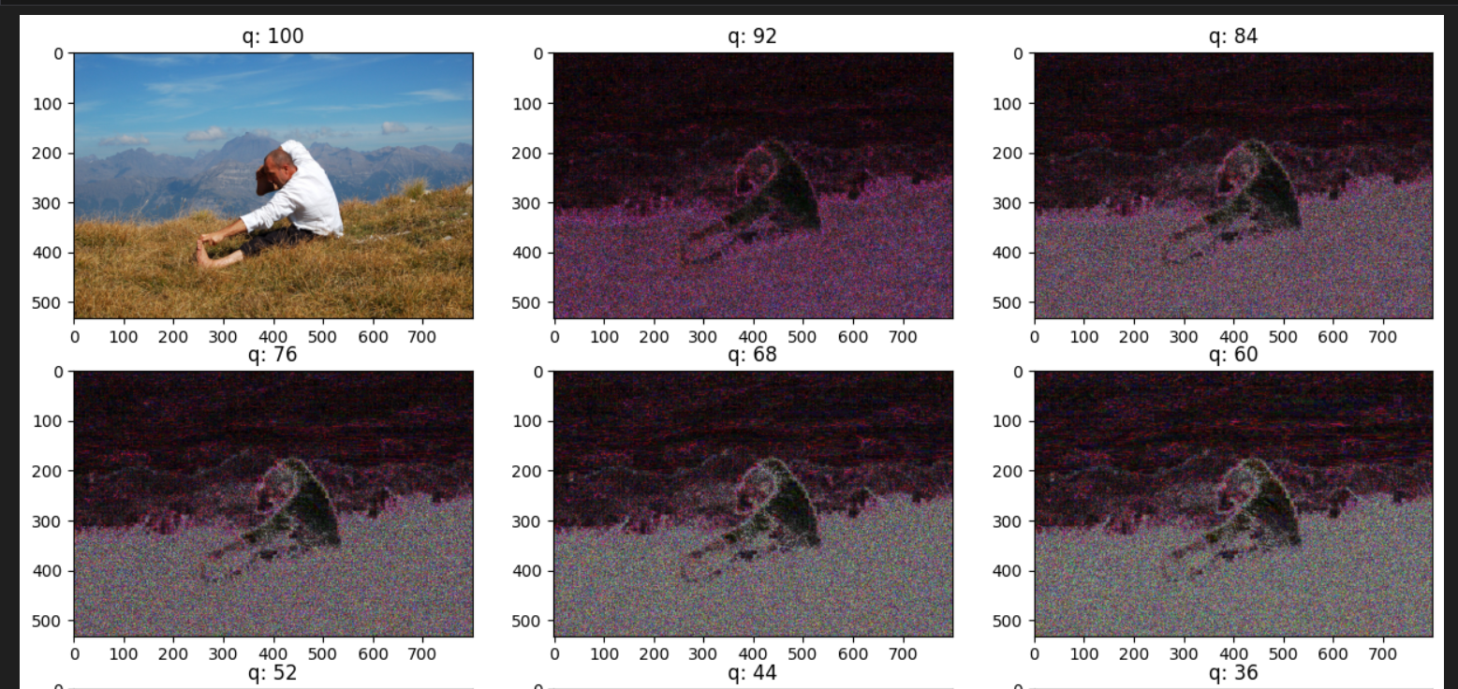
Data Analysis
Data preprocessing:
MobileNetV3:
Image size is resized to 224x224 pixels and pixel values rescaled to the 0-1 range. Batch size is set to 32
Data cleaning: Invalid/corrupted images are removed from the dataset
Error rate analysis: Use ELA functions to create Error Level Analysis (ELA) images for tamper detection
Data augmentation: Configured augmentation laters for random flipping, rotation, zoom, height, and width adjustments.
Mediapipe + YogaConvo3d:
Mediapipe pose module: Used the module to detect human poses in pose images
3D voxel grid: Defined 3D voxel grid size of 32x32x32 for each pose image.
First, Mediapipe landmarks (for key body positions) were normalised to fit within the voxel grid
Second, Bresenham’s algorithm is used to connect landmarks with lines in a 3D voxel grid
Third, the grid is reflected about X-axis for the correct orientation
Presenter: Renhua Luo (z5408176)

Slide 9
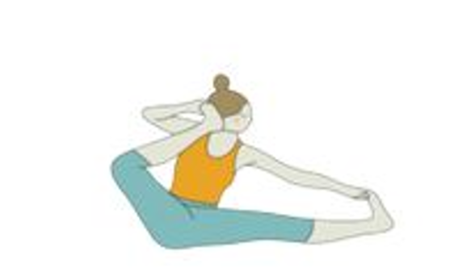
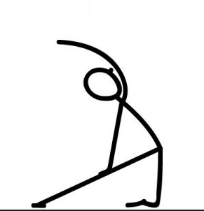

Data Analysis (cont.)
DenseNet:
Image size is resized to 224x224 pixels and pixel values rescaled to the 0-1 range.
Skipped any unreadable images
Converted data to NumPy arrays for use in model training and testing
Performed data augmentation by Horizontal and vertical flips, Rotation, Zoom, Width and height shifts and Shear
Xception:
Data augmentation: Used ImageDataGenerator for data augmentation with the following transformation:
Rotation
Width and height shifts
Zoom range
Horizontal flip
Brightness range
Validation split
Rescale pixel values to the range [0, 1] by dividing by 255
Resized images to 256x256
Data limitation:
Since the images were downloaded from various websites. Some websites were no longer accessible and thus 18,600 out of 28,000 images were downloaded (33.6% loss of data). In addition, some images are invalid and thus need to be discarded.
A subset of the images are cartoon and random images. Some of the poses are different from each other despite being in the same class
Presenter: Renhua Luo (z5408176)

Slide 10
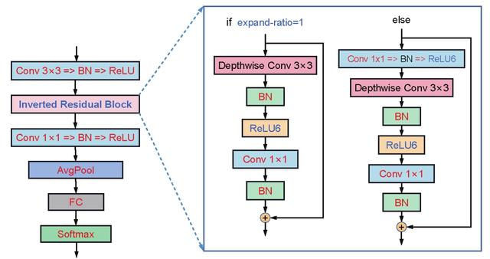
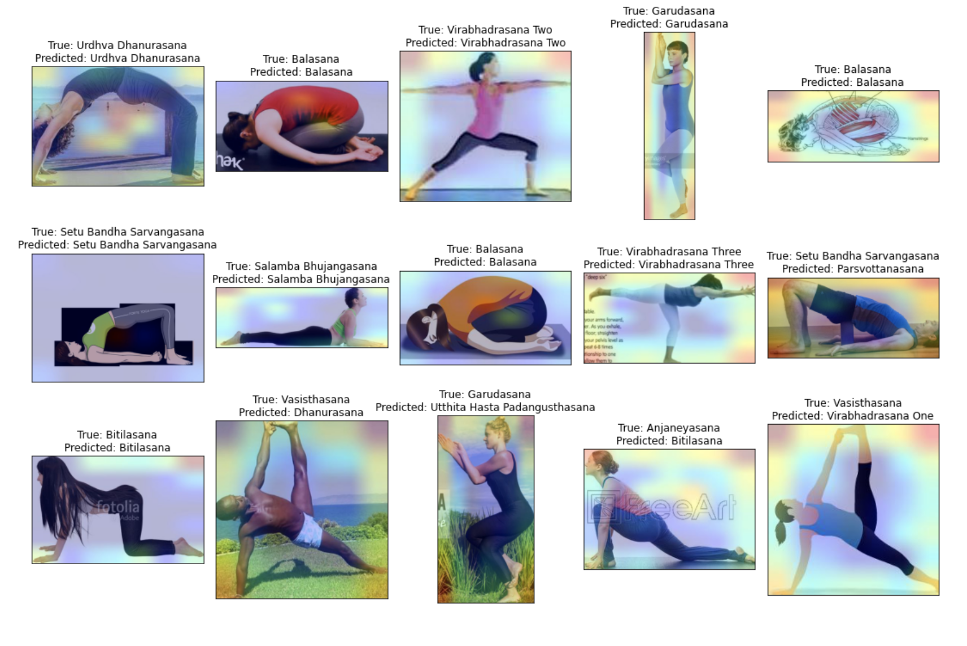
Method(s)
CNN+MobileNetV3 Model
Utilizes the efficient MobileNetV3 Large architecture with transfer learning, incorporating extensive data augmentation techniques. Features custom dense layers (512/256 units) with dropout, optimized using Adam optimizer and advanced training strategies including early stopping and Grad-CAM visualization for model interpretation.
Presenter: Hesong Zhang (z5532689)
Notes:
"Let me walk you through the exciting architectures we implemented for this project... [pause]
Starting with MobileNetV3 - While it sounds technical, what we did was quite clever: we designed a neural network that progressively narrows down from five hundred and tween neurons to two hundred and fifty six, and finally to eighty-two - one for each yoga pose. The real magic here is in the optimization - we used the Adam optimizer with a very small learning rate, making it incredibly efficient for mobile devices.

Slide 11
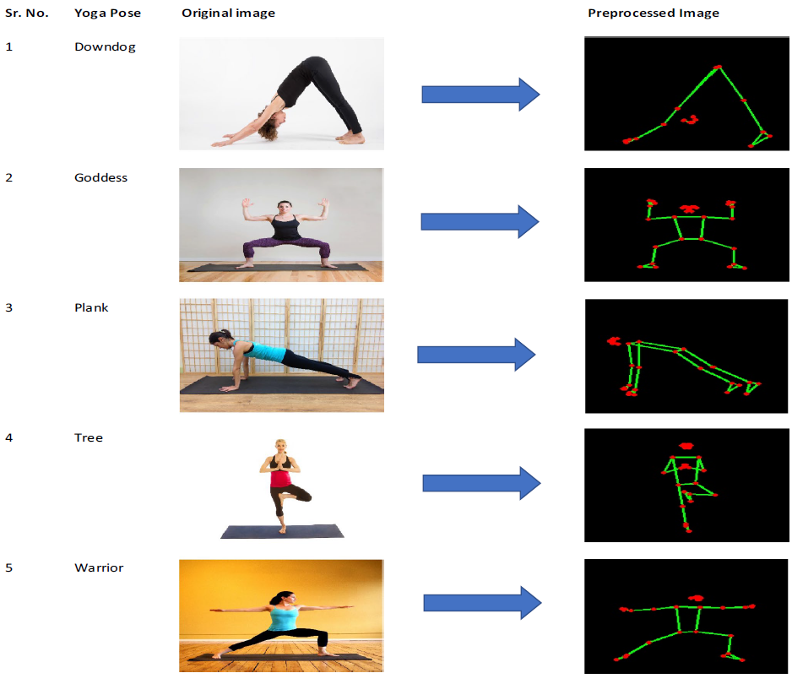
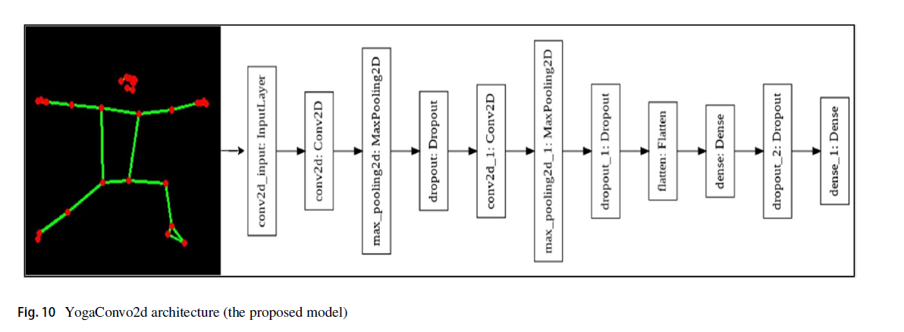
Method(s)
3DCNN+MediaPipe (YogaConv3d)
A novel 2-part yoga pose classification system where:
First, 2D images are processed by Google Mediapipe and the 3D body pose informations are encapsulated within 32x32x32 3-dimensional voxel grid. Bresenham's 3D line algorithm is used to preserve skeletal structure.
Second, the voxel grids are then trained by a light-weight 3D CNN (YogaConv3d) with quick training time (30 minutes on GTX1050). The model features three 3D convolutional layers (64/128/256 filters) with 3D max pooling and dropout regularization, followed by two dense layers (1024 units and 82 output classes) for final classification. Optimized with Adam optimizer and cross-entropy loss, the model supports CUDA GPU acceleration for efficient training and inference.
Presenter: Hesong Zhang (z5532689)
Notes:
Then there's our custom CNN+MediaPipe model, a novel 3D CNN approach to yoga pose classification. Our system transforms 2D images into 32*32*32 cubed voxel representations, where our YogaConv3d architecture, featuring three convolutional layers with dropout regularization, effectively processes spatial pose patterns. Powered by GPU acceleration, it achieves robust classification while preventing overfitting.

Slide 12
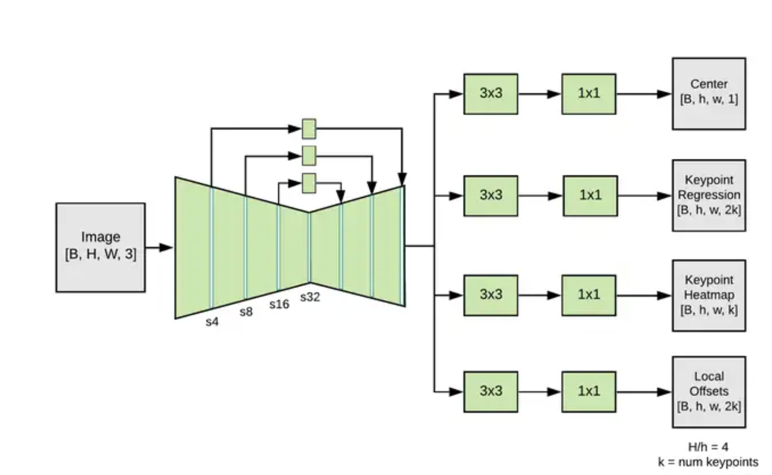
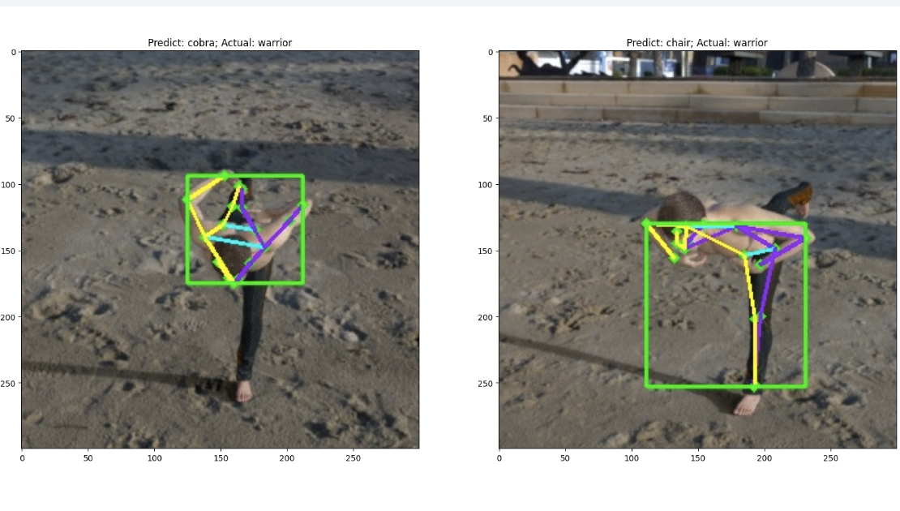
Method(s)
MoveNet-based Pose Model
Combines MoveNet Thunder pose estimation with a custom neural network classifier. Processes 17 body landmarks through normalization and embedding layers, specializing in skeleton-based pose recognition. Includes comprehensive preprocessing for pose centering and size normalization.
Presenter: Hesong Zhang (z5532689)
Notes:
Now, here's where it gets really interesting... [pause] The MoveNet approach takes a completely different path. Instead of looking at the whole image like the others, it first identifies seventeen key anatomical landmarks on the body. We implemented sophisticated normalization techniques to ensure that whether you're tall or short, the model sees the pose the same way. [pause]
Input Image ([B, H, W, 3]):
The input is an image with shape [B, H, W, 3], where B is the batch size, H is the height, W is the width, and 3 represents the RGB color channels.
Feature Extraction Backbone:
The central green structure represents the feature extraction backbone, which processes the input image and extracts essential features for pose estimation. This backbone can be a convolutional neural network (CNN) or another model that captures spatial patterns in the image.
Branches for Different Outputs:
After feature extraction, the network branches into multiple output heads, each responsible for a specific aspect of pose estimation. Each branch consists of layers with 3x3 and 1x1 convolutions to refine features for specific outputs. The outputs are:
Center ([B, h, w, 1]): A center heatmap to identify the central area of each person in the image. This helps in detecting where each person is located.
Keypoint Regression ([B, h, w, 2k]): A regression map that predicts the precise position of each keypoint. Here, k is the number of keypoints per person, and each keypoint has 2 values (x and y coordinates).
Keypoint Heatmap ([B, h, w, k]): A heatmap that highlights the locations of specific keypoints, like shoulders, elbows, knees, etc., for each person.
Local Offsets ([B, h, w, 2k]): These offsets provide finer adjustments to the keypoint positions, allowing for sub-pixel accuracy. They are used to correct the position predicted in the heatmap by refining it to the exact location.
Output Dimensions:
Each output has spatial dimensions [h, w], which are lower resolution versions of the original image dimensions [H, W] due to downsampling in the feature extraction process. The outputs are designed to be interpretable in terms of the original image coordinates.

Slide 13
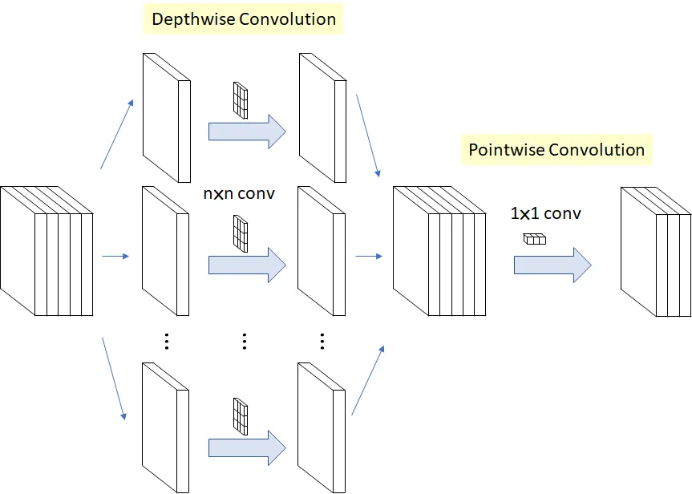
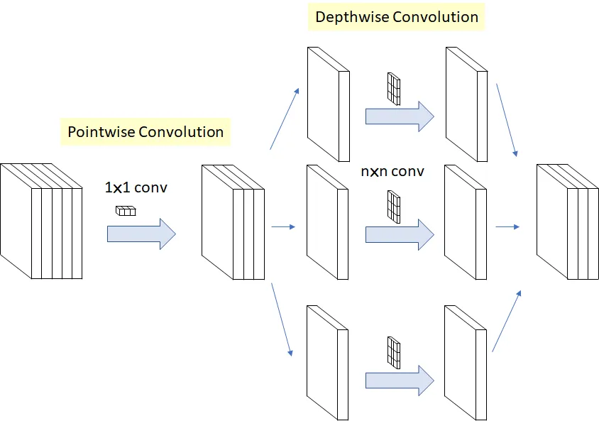
Method(s)
Xception Model
Implements a two-stage transfer learning approach with the Xception architecture. Stage one trains only the top classifier while keeping the base model frozen, followed by selective fine-tuning. Features comprehensive data augmentation and a progressive learning rate scheduler, with dense layers (512/256 units) and dropout for effective regularization.
Presenter: Hesong Zhang (z5532689)
Notes:
For Xception, we got a bit more sophisticated with a two-phase training strategy. First, we used transfer learning - base on a pre-trained model - and only trained the top classifier layers with our five hundred and twenfy to two hundred and fifty six
-unit configuration. Then in phase two, we carefully fine-tuned the deeper layers at a very small learning rate. It's like teaching a artist to paint in a new style.
Q1: Why does this model use a two-stage training strategy? What are the characteristics of each stage?
Q1: 为什么这个模型采用两阶段训练策略？每个阶段的特点是什么？
A1: The two-stage strategy aims to better utilize pre-trained weights:
- First stage (30 epochs): Freeze Xception backbone, only train classification layers, quickly adapt to target task
- Second stage (70 epochs): Unfreeze last 20 layers for fine-tuning, making features more suitable for yoga pose classification
Q3: How is the learning rate scheduling strategy designed?
Q3: 学习率调度策略是如何设计的？
A3: Multi-stage decreasing strategy:
A3: 多阶段递减策略:
- Progressive decay helps stable model convergence
- 渐进式衰减有助于模型稳定收敛
Q5: What is the structure of this model?
Q5: 这个模型的结构是怎样的？
A5: The model consists of two parts:
A5: 模型由两部分组成:
- Base network: Pre-trained Xception
- 基础网络: 预训练的Xception
- Classification head: GlobalAveragePooling2D + Two Dense layers with Dropout (512/256 nodes) + Softmax output
这张图展示了Xception架构的核心创新 - 从传统Inception模块到深度可分离卷积的演变：
This reorganization of operations forms the basis of depthwise separable convolutions, making Xception more efficient than traditional CNN architectures. 这种运算的重组形成了深度可分离卷积的基础，使Xception比传统CNN架构更高效。

Slide 14
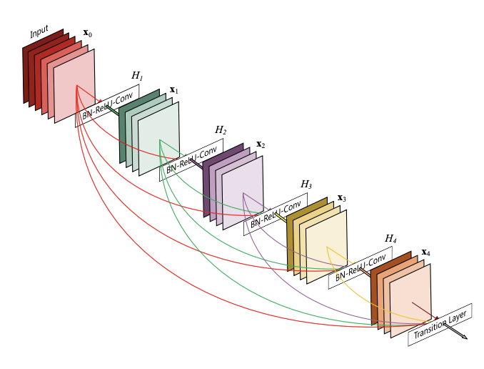
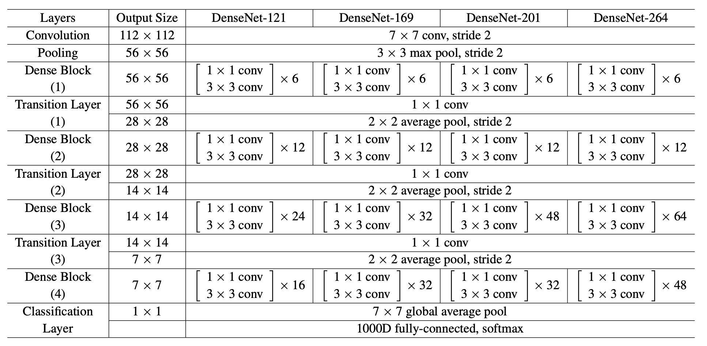
Method(s)
DenseNet201 Model
Employs DenseNet201 architecture with transfer learning, featuring frozen first 100 layers and custom top layers. Uses comprehensive data augmentation with rotations, zooms, and flips. Implements progressive learning rate scheduling from 0.001 to 0.000005 across epochs. Achieves 79% validation accuracy through tuned training strategy with early stopping and model checkpointing.
Presenter: Hesong Zhang (z5532689)
Notes:
Finally, we have DenseNet201. [pause] This implementation really showcases the power of modern deep learning. We leveraged the ImageNet-pretrained weights, kept the one hundred layers frozen, and added our own classifier with Global Average Pooling. The training process took a hundred epochs, but the results speak for themselves.
Thank you for your attention. Let go to the result of these model"

Slide 15
Results - Accuracy and Test loss
Architecture | Accuracy | Test - Loss
DenseNet201 | 79.00 | 0.8163
CNN + MobileNetV3 | 72.67 | 1.1267
MoveNet | 88.22 | 0.5669
3D CNN + MediaPipe | 77.29 | 1.0922
Xception | 79.63 | 1.0694
Presenter: Klaus Yu (z5546743)

Slide 16
Results - Best 3 precision classes
Architecture | Class1 | Accuracy | Class2 | Accuracy | Class3 | Accuracy
DenseNet201 | Yogic_sleep_pose | 100 | Warrior_II_Pose_or_Virabhadrasana_II_ | 98 | Plow_Pose_or_Halasana_ | 97
CNN + MobileNetV3 | Standing_big_toe_hold_pose_or_Utthita_Padangusthasana | 98 | Extended_Revolved_Triangle_Pose_or_Utthita_Trikonasana_ | 94 | Warrior_II_Pose_or_Virabhadrasana_II_ | 94
MoveNet | Extended_Puppy_Pose_or_Uttana_Shishosana_ | 100 | Yogic_sleep_pose | 100 | viparita_virabhadrasana_or_reverse_warrior_pose - | 100
3D CNN + MediaPipe | Staff_Pose_or_Dandasana_ | 100 | Pigeon_Pose_or_Kapotasana_ | 100 | Noose_Pose_or_Pasasana_ | 100
Xception | Extended_Puppy_Pose_or_Uttana_Shishosana_ | 100 | Downward-Facing_Dog_pose_or_Adho_Mukha_Svanasana_ | 98 | Extended_Revolved_Triangle_Pose_or_Utthita_Trikonasana_ | 97
Presenter: Klaus Yu (z5546743)
Notes:
In this page, we will take a look at the best 3 prediction classes in each model.
We can see whatever the model we chose, we always have some common classes that have high accuracy
1. the highest precision of common class belongs to Extended Puppy Pose, it got 100 percent in both MoveNet and Xception
2. The second one is the Yogic sleep pose which has 100 percent precision in both DenseNet201 and MoveNet
3. The next one goes to the Extended Revolved Triangle, it got 94 percent in CNN + MobileNetV3 and 97 Percent in Xception
4. The last one is the Warriror two pose which got 98 percent in DenseNet201 and 94 percent in CNN + MobileNetV3

Slide 17
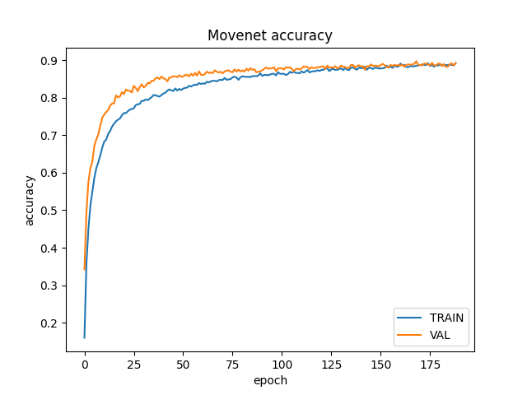
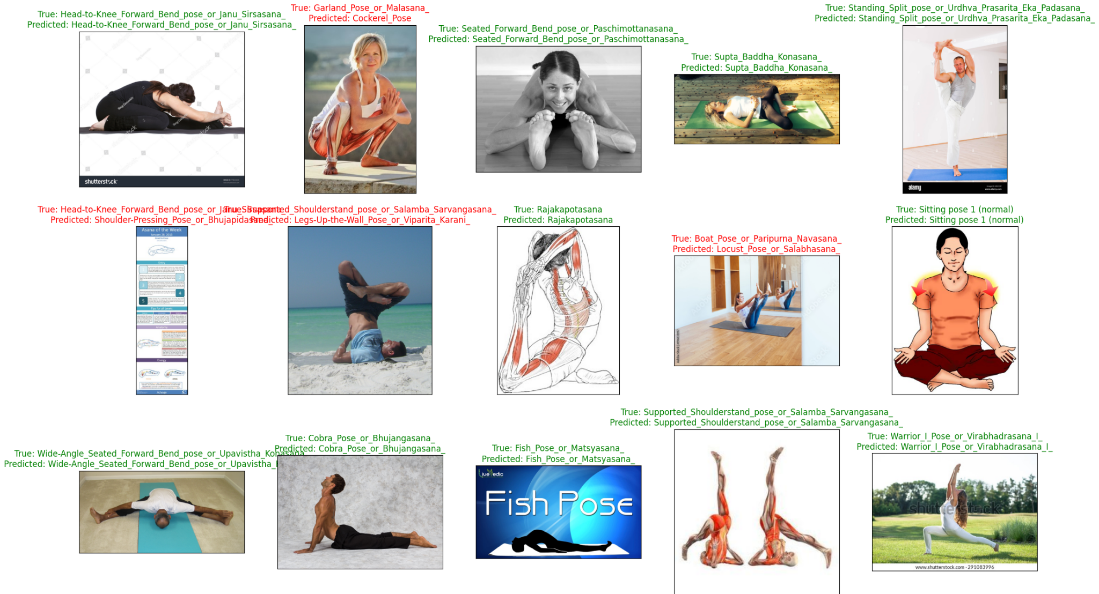
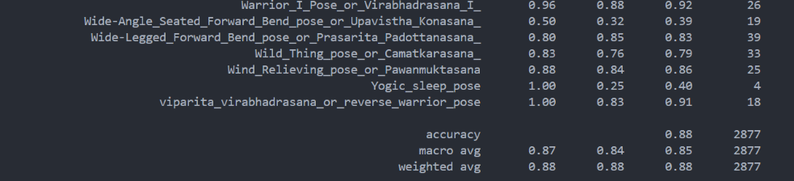
Best Model - MoveNet
Presenter: Klaus Yu (z5546743)
Notes:
In this page, we will look at our best model - MoveNet,
We can see from the loss curves that there is no overfitting occurs when training and validating
Also we got descent confusion matrix as well.
We made a visulization of some samples with the correct classified images and their labels. In order to make it more visible for developer.

Slide 18
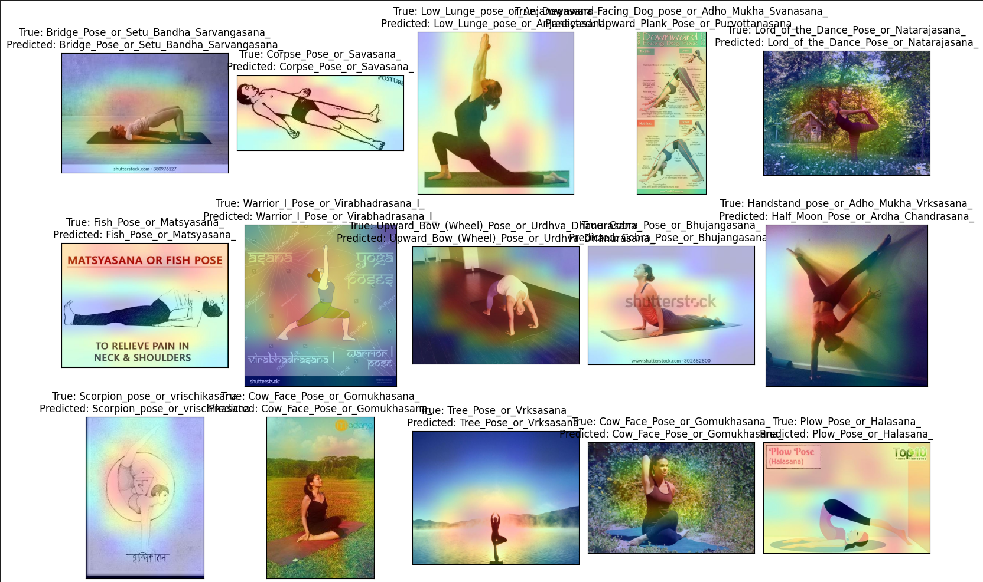
Grad-Cam Visualization
Explain model decisions
Discover model bias
Improve user trust
Presenter: Klaus Yu (z5546743)
Notes:
In yoga pose classification, （Gradient-weighted Class Activation Mapping） is a deep learning visualization tool that helps explain the model's classification process.
It generates a heat map to mark the areas in the image that have the greatest impact on the classification results.
We implement this map since The Grad-CAM helps us to
1. allowing researchers to understand the key areas that the model focuses on;
2. Discover whether the model has bias, such as focusing on areas that are not related to classification;
3. also allowing users to more intuitively see how the model "sees" the image

Slide 19
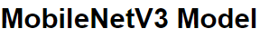
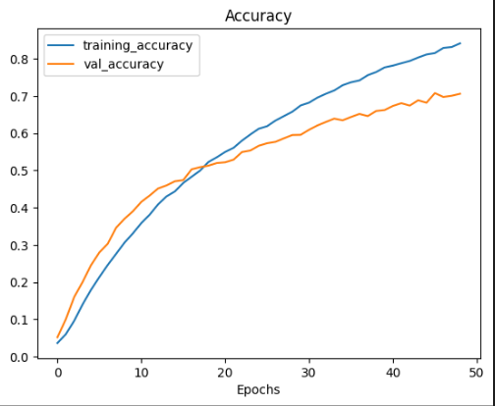
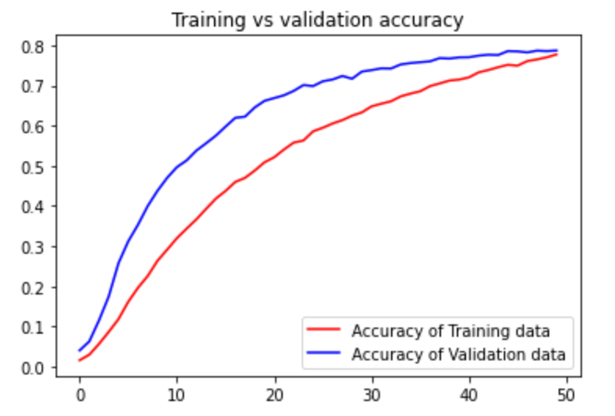
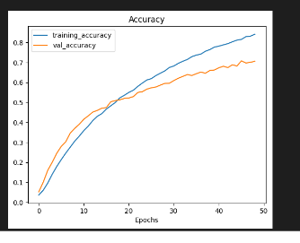
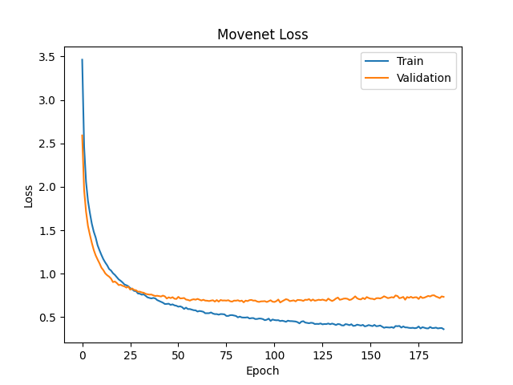
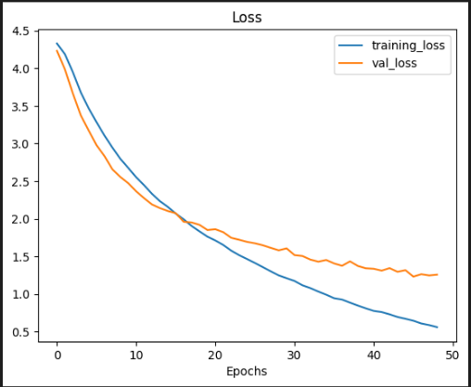
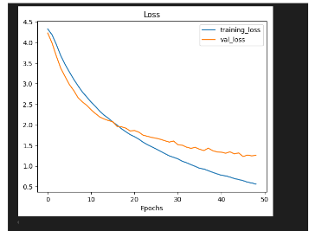
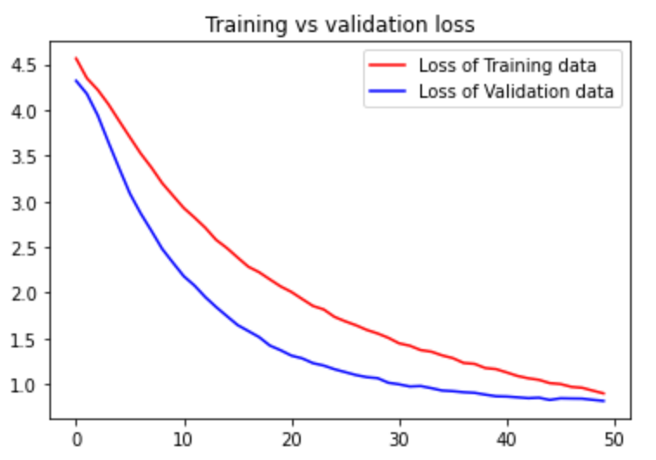
Discussion_Accuracy&loss
Densenet 201
3DCNN + Mediapipe
Presenter: Yi Zhao (z5530832)
Notes:
Training Accuracy (MovNet vs. MobileNetV3): The MovNet model converges faster on the training set,
Validation Accuracy (MovNet vs. MobileNetV3): MovNet’s validation accuracy reaches near convergence at earlier epochs, indicating good generalization to new data.
Training Loss (MovNet vs. MobileNetV3): MovNet’s training loss drops quickly and stabilizes, demonstrating high learning efficiency
MoveNet: Reaches high accuracy quickly with stable training, showing lower validation loss, indicating a well-generalized model.
MobileNetV3: Moderate accuracy increase over epochs, with a relatively stable gap between training and validation accuracy.
DenseNet201: Strong improvement in accuracy but shows a higher validation loss than other models, possibly indicating overfitting.
3DCNN + MediaPipe: Similar performance to MobileNetV3 with steady accuracy growth; validation loss converges with training loss, suggesting good generalization for posture recognition.

Slide 20
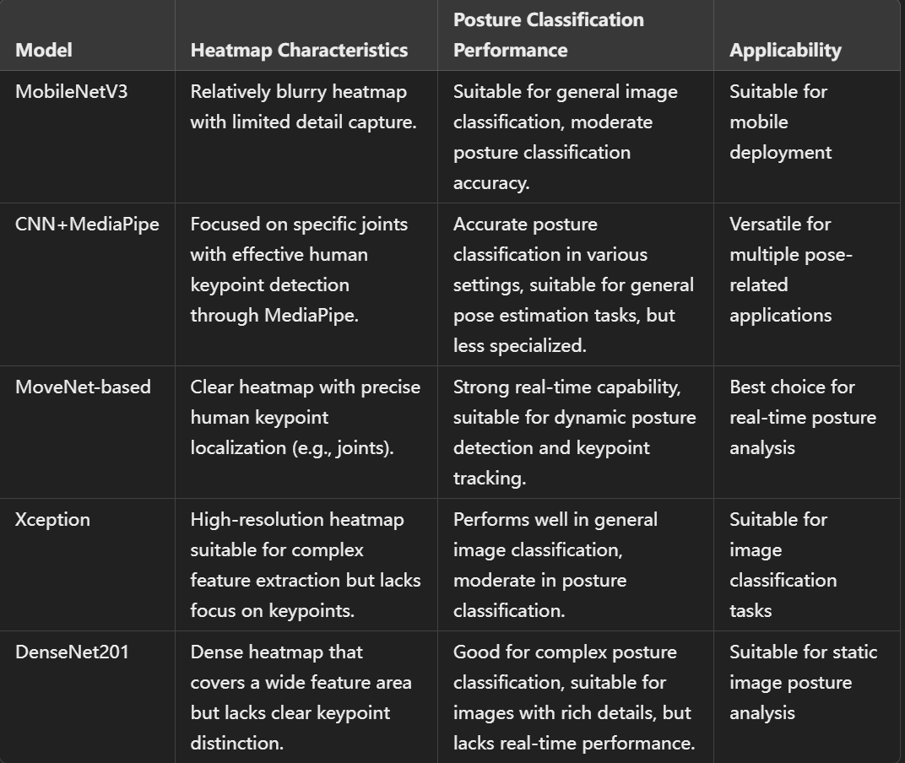
Discussion
_table
Presenter: Yi Zhao (z5530832)
Notes:
1、MobileNetV3 vs MoveNet-based Pose Model：MobileNetV3 is compact for mobile use but less precise in posture classification than MoveNet, which excels at real-time keypoint detection.
2、CNN+MediaPipe: Offers versatile and accurate posture classification through effective keypoint detection, suitable for general pose estimation tasks
3、Xception vs DenseNet201：Xception is efficient for general classification, whereas DenseNet201 captures complex postures better but isn’t suitable for real-time use.
4、MoveNet-based Pose Model vs Xception & DenseNet201：MoveNet is ideal for keypoint-based posture tracking, while Xception and DenseNet201 are better suited for traditional classification tasks.
5、MobileNetV3 vs CNN+MediaPipe: MobileNetV3 is good for general lightweight tasks, whereas CNN+MediaPipe performs better on precise keypoint detection for pose estimation.

Slide 21
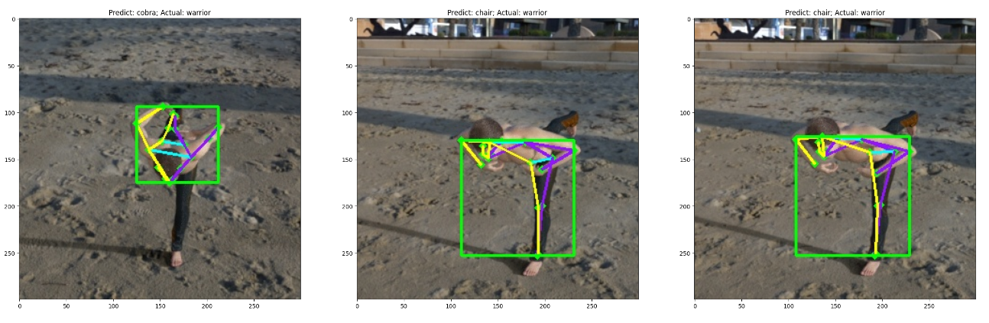
Conclusion
MoveNet-based Pose Model is the best choice for posture classification and real-time tracking, suitable for dynamic detection.
CNN+MediaPipe provides accurate keypoint detection for general pose estimation, adaptable but less specialized for specific postures.
MobileNetV3, Xception, and DenseNet 201 perform well i general classification tasks but are not ideal for specialized posture analysis, especially in real-time applications.
Presenter: Yi Zhao (z5530832)

Slide 22
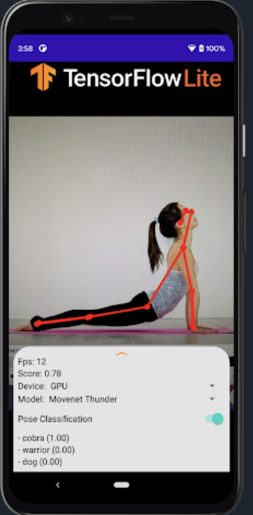
Conclusion
Strengths of MoveNet:
1、Scalability and Efficiency: MoveNet is lightweight, real-time, and ideal for mobile and edge deployment. 2、High Accuracy: Delivers precise human key point detection, tailored for tasks needing quick, accurate pose estimation.
3、Real-Time Performance: Optimized for fast, on-device pose detection.
Limitations and Weaknesses of MoveNet:
Pose Complexity: Struggles with complex or multi-person poses, limiting use in crowded scenes.
Occlusions: Accuracy drops when body parts are occluded or partially visible.
Customization: Limited flexibility for fine-tuning compared to more configurable models.
Presenter: Yi Zhao (z5530832)
Notes:
Scalability and Efficiency: MoveNet is lightweight and optimized for real-time inference, making it highly efficient and suitable for deployment across various devices, including mobile and edge devices.
High Accuracy: MoveNet achieves high accuracy in pose estimation by leveraging a streamlined architecture tailored specifically for fast and precise detection of human key points, ideal for tasks requiring real-time precision.
Real-Time Performance: Optimized for fast, real-time pose detection on mobile and edge devices.

Slide 23
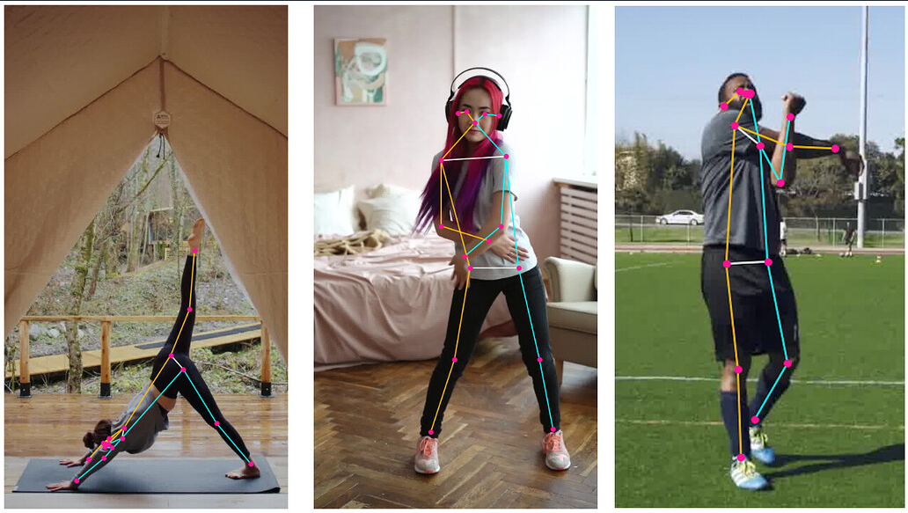
Improvement
1、Convert the pose classification model to TensorFlow Lite：deploy it to mobile apps, web browsers and edge devices.
2、Multi-Person Support: Enhance the model to accurately detect and track multiple individuals in crowded environments, as MoveNet currently excels primarily in single-person tracking.
3、Multi-scale Input: Introduce multi-scale input images to improve detection accuracy for people of different sizes.
Presenter: Yi Zhao (z5530832)
Notes:
Skeletal Prior Information: Use skeletal structure constraints to optimize keypoint positions, reducing incorrect detections.
Temporal Information Fusion: Incorporate temporal information in video processing to increase frame-to-frame consistency and reduce jitter.
Lightweight Model: Apply model pruning and quantization techniques to reduce model size and computation, speeding up inference.
Data Augmentation: Use augmentation techniques like rotation, scaling, and occlusion to improve the model's robustness to different poses.
Knowledge Distillation: Transfer knowledge from a large model to a lightweight model to improve the accuracy of the lightweight version.
Domain Adaptation: Fine-tune for specific application scenarios (such as sports or dance) to improve accuracy in that context.

Slide 24

Any questions?
This Photo by Unknown Author is licensed under CC BY-SA

Slide 25
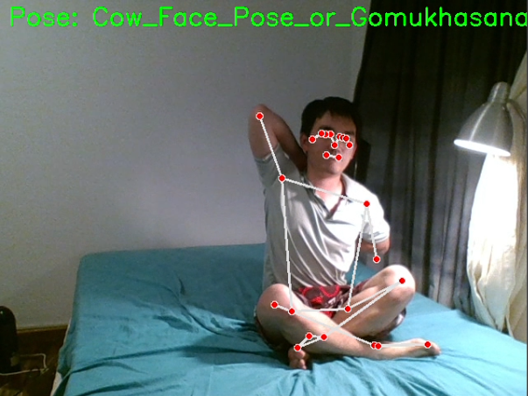
One more thing: Live Demo

